Slide 1

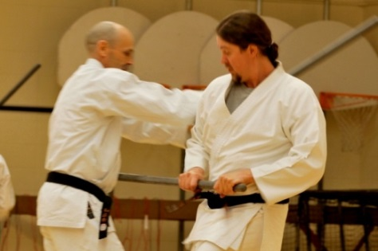
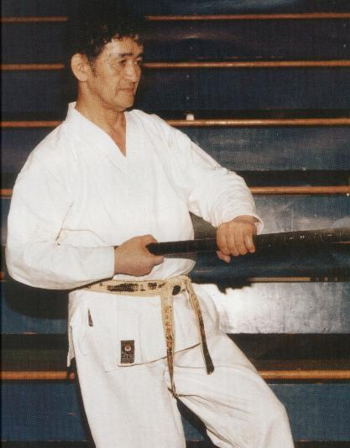
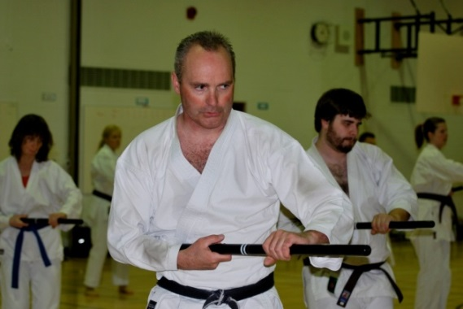
Shindo Clinic on Saturday, February 27th, from 10-2 at St. Mary’s School, 5630 Mink Creek Rd., Whitecourt
Shindo Clinic
Instructor:
Sensei Walter Greening
4th degree Black belt
* For those interested there will be a grading in conjunction with the clinic
Who can train in Shindo?
13 years of age & older
10 years of age & a minimum of orange belt
The Shindo is taught to both karate & non-karate students. Basic blocks and strikes are practiced to make it a functional defense tool. A number of Katas (pre-arranged routines) are taught to compliment the students’ practice of the weapon.
Sensei Shintani studied karate for much of his life. He had a dream that developed from his love and understanding of the martial arts, and this dream was Shindo. Nearly 40 years since he developed Shindo, and almost 30 years since his first instruction, Shindo is a reflection of all that is Shintani Wado Kai Karate in its entirety. The Shindo is a 36” stick which was devised by Masaru Shintani Sensei, 9th Dan, in the early 1970’s.

